Slide 1
Reading, Writing and Pyrithmetic
Lesson 3.2
Notes:
1.1

Slide 2
Class Objectives
By the end of today’s class you will be able to:
Read data into Python from CSV files.
Write data from Python to CSV files.
Zip two files together and know when this is helpful.
Understand well how to create and use Python functions.
Notes:
1.1
Welcome students to today's class and reassure them that, even though this stuff is tough, practice makes perfect. The more they work with Python, the more sense it will make.

Slide 3
Activity: Python Check-Up
In this activity, you will start with a quick warm up activity to get the Python juices flowing!
10 Minutes
Notes:
1.2

Slide 4
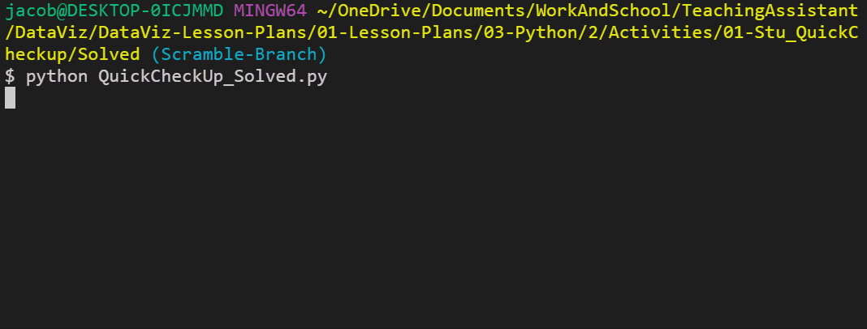
Activity: Python Check-Up
Instructions:
Create simple Python command line application. The application should:
Print: “Hello User!”
Then ask: “What is your name?”
Then respond: “Hello <user’s name>”
Then ask: “What’s your age?”
Then respond: “Awwww… you’re just a baby!” or “Ah… A well traveled soul are ye.” depending on the user’s age.
Notes:
1.2
Run 01-Stu_QuickCheckup/quick_check_up.py within the terminal so that students can see what they are making before slacking out the starter file and instructions.

Slide 5

What time is it? It's showtime!
Nope! It’s time to check your
SLACK!
Notes:
Slack out 01-Stu_QuickCheckup/quick_check_up.py

Slide 6
Notes:
1.3
Check LP or see below:
Go over the code with the class, answering any questions students may have regarding the activity.
Key points to cover during the discussion of this code:
The name variable is being set to whatever the user inputs as their response to the question "What is your name?"
Since the age variable is taken in as a string when inputted, it has to be cast as an integer when run through the conditionals.

Slide 7
Loop Recap
Notes:
2.1
Before moving forward ask the class how many loops have we learned last class and which one are they.

Slide 8
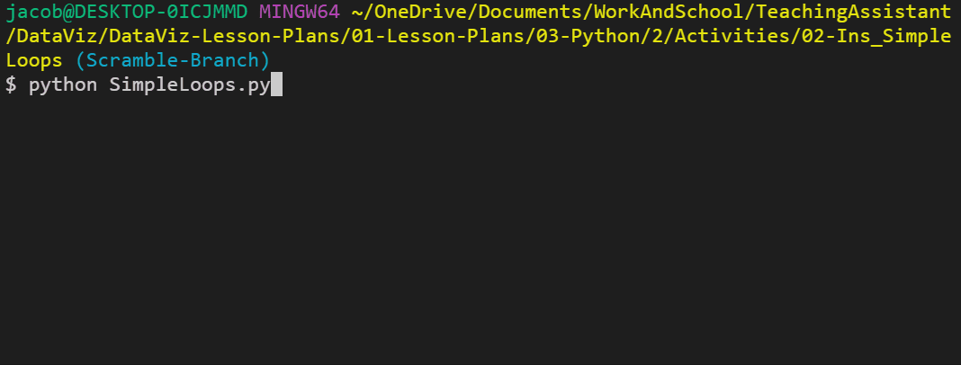
Loop Recall
For loop
Loops through a range of numbers, the letters in a string, or the elements within a list one by one.
Notes:
2.1
Run 01-Stu_QuickCheckup/quick_check_up.py within the terminal so that students can see what they are making before slacking out the starter file and instructions.

Slide 9
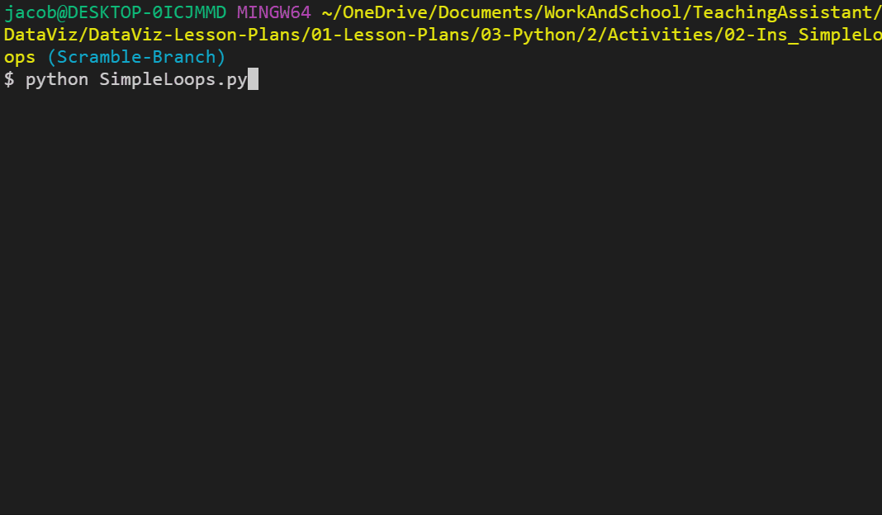
Loop Recall
While loop
Loops through the code contained inside of it until some condition is met.
Notes:
2.1
Run 01-Stu_QuickCheckup/quick_check_up.py within the terminal so that students can see what they are making before slacking out the starter file and instructions.

Slide 10
Notes:
Return to the lesson plan and continue with the instructions for the remainder of the activity.

Slide 11
Activity: Kid in a Candy Store
In this activity, you will be placed in the role of a kid going with their parents to the supermarket. After pestering their parents for a while, they finally are allowed to pick out some candy to take home.
15 Minutes
Notes:
2.2

Slide 12
Activity: Kid in a Candy Store
Instructions:
Create a loop that prints all of the candies in the store to the terminal with their index stored in brackets beside them.
For example: “[0] Snickers”
Create a loop that runs for a number of times as determined by the variable allowance.
For example: If allowance is equal to five, the loop should run five times.
Each time this second loop runs, take in a user's input - preferably a number - and then add the candy with a matching index to the variable candy_cart.
For example: If the user enters "0" as their input, "Snickers" should be added into the candy_cart list.
Use another loop to print all of the candies selected to the terminal.
Bonus: Create a version of the same code which allows a user to select as much candy as they want up until they say they do not want any more.
Notes:
2.2
Open up the 03-Stu_KidInCandyStore/kid_in_candy_store.py within the terminal and run through the application to show students how it functions.

Slide 13
Notes:
2.3
Key points to cover in the discussion of this code:
There are three For loops being used in this activity. One to print out the original candy list. A second to collect all of the candy choices the user has. And a third to print the final list of choices to the screen.
When adding candies into the candy_cart list, the selection variable has to be cast as an integer since all inputs are naturally set as strings.
In order to solve the bonus, we would simply use a While loop instead of a For loop, asking after each selection whether the user would like to make another selection. If they ever answer anything other than "Yes", the loop will stop.

Slide 14
Activity: House of Pies
In this activity, you will be constructing an order form that will display a list of pies and then prompt users to make a selection. It will continue to prompt for selections until the user decides to terminate the process.
20 Minutes
Notes:
3.1
This activity comes in three parts: an easy version that is very much like the previous activity and a hard version which is very challenging. Encourage students to try their luck on the hardest version if they are feeling confident.

Slide 15
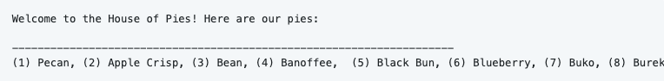
Activity: House of Pies
Instructions:
Part 1
Create an order form that will display a list of pies to the user in the following way:
Then prompt the user to select which pie they'd like to order via number.
Immediately after, follow the order with Great! We’ll have that <PIE NAME> right out for you and then ask if they would like to make another order. If so, repeat the process.
Once the user is done purchasing pies, print the total number of pies ordered.
Notes:
3.1
Open up the 04-Stu_HouseOfPies/Solved/house_of_pies_bonus.py within the terminal and run through the application to show students how it functions.

Slide 16
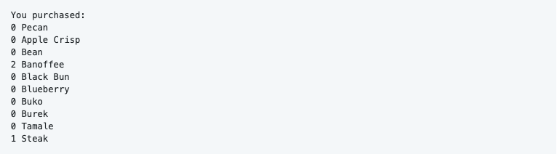
Activity: House of Pies
Instructions:
Part 2
Modify the application once again, this time conclude the user's purchases by listing out the total pie count broken by each pie.
Notes:
3.1

Slide 17
Notes:
3.2
Check LP or see below:
Slack out the 04-Stu_HouseOfPies/house_of_pies_bonus.py of the previous activity and go over the code with the class, answering whatever questions they may have.
Important points to touch upon during this discussion:
Since the GUI for the application starts with 1, the user's input must be subtracted by 1 one when referencing the pie's actual index. This is because all indices start at 0 naturally.
The primary loop being used is a While loop that is constantly checking whether the user's response to the question Would you like to make another purchase? ever changes from y
The means by which the total number of pies is calculated in the original solution is by determining the length of the pie_purchases array.
Within the bonus, the means by which the code is keeping track of how many pie purchases are being made for each type of pie is by having a second list that corresponds to the first filled with 0 values. Every time a pie is chosen, therefore, the code adds one to the index of the pie_purchases list that is equal to that of the original pie_list.

Slide 18
Reading Text Files
Notes:
4.1

Slide 19
Python can read data in from external text files to perform some tasks on it!
Notes:
4.1
Another function of Python is that it is capable of reading data in from external text files and then performing some tasks on it.

Slide 20
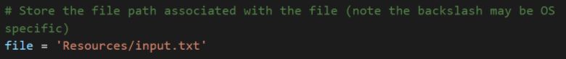
Reading Text Files
As we all need directions to move from point A to point B, Python is no different when dealing with external files. It requires very precise directions on what path to follow in order to reach the desired file.
In this case the desired file is located within a sub-folder called “Resources”, the path we need to tell Python would be “Resources/FileName.txt”.
NOTE: Different operating systems use different ways to set their paths.
Notes:
4.1
Open up 05-Ins_BasicRead/read_file.py and 05-Ins_BasicRead/Resources/input.txt, going over the syntax and purpose of the code contained within.
When dealing with external files, Python requires very precise directions on what path to follow to reach the desired file. As such, if the desired file is stored within a sub-folder called "Resources", the path needed would be "Resources/FileName.txt".
It is critical to note that different operating systems use different paths to locate files. For example: Windows machines will often use forward slashes to separate folders while Mac devices will use backslashes.

Slide 21
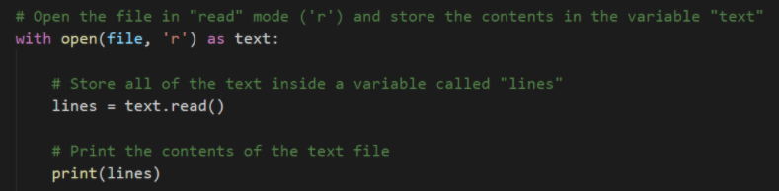
Reading Text Files
with is a special syntactical block that allows to perform operations that require a safety ‘clean-up’ after the code block is completed.
open<File Path>, <Read/Write> is the function Python uses to open a file. The function can be specified with ‘r’, ‘w’, or ‘rw’, in order to only read, only write, or performed both operations.
text.read() reads the entire file converting to a string type.
Notes:
4.1
The with statement is simply saying that, for as long as we are dealing with the code within the following block, save the text variable. Once the code block has completed, the text variable will be "cleaned up" and removed to save memory.
open(<File Path>, <Read/Write>) is the function Python uses in order to open up and work with external text files. By specifying either 'r', 'w', or 'rw', users can use the open() function to either read from a text file, write to a text file, or perform both operations in the code block that follows it.
text.read() parses the data that is read in by the open() function and converts it into a string type. If this function was not used all that would be printed to the screen would be an unhelpful text wrapper object.achines will often use forward slashes to separate folders while Mac devices will use backslashes.

Slide 22
Introduction to Modules
Notes:
4.2

Slide 23

😱No built-in
function for
my specific
task
Relax! We can bring in external modules to perform the specific task.
Notes:
4.2
While Python includes many built-in functions, sometimes coders have to bring in external modules in order to perform specific tasks.
Tell the class:
If a coder wanted a random number generator for a dice game they were making, for example, they would most likely want to use the random module instead of having to create the code from scratch.
Importing modules into Python is actually very simple. All that is required is for the module to be installed and for the user to import the module into their code.
All of the modules for today come packaged with Python, so there is no need to install anything new.

Slide 24
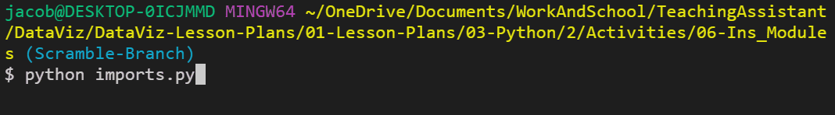
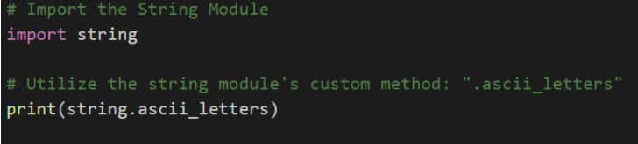
Introduction to Modules
Import Modules
The string module contains many helpful constants and methods which pertain to strings. For example, users can use string.ascii_letters and Python will instantly grab a reference to every ascii character.
Notes:
4.2
Open up 06-Ins_Modules/imports.py within your editor and show the class how to import modules into their code.

Slide 25
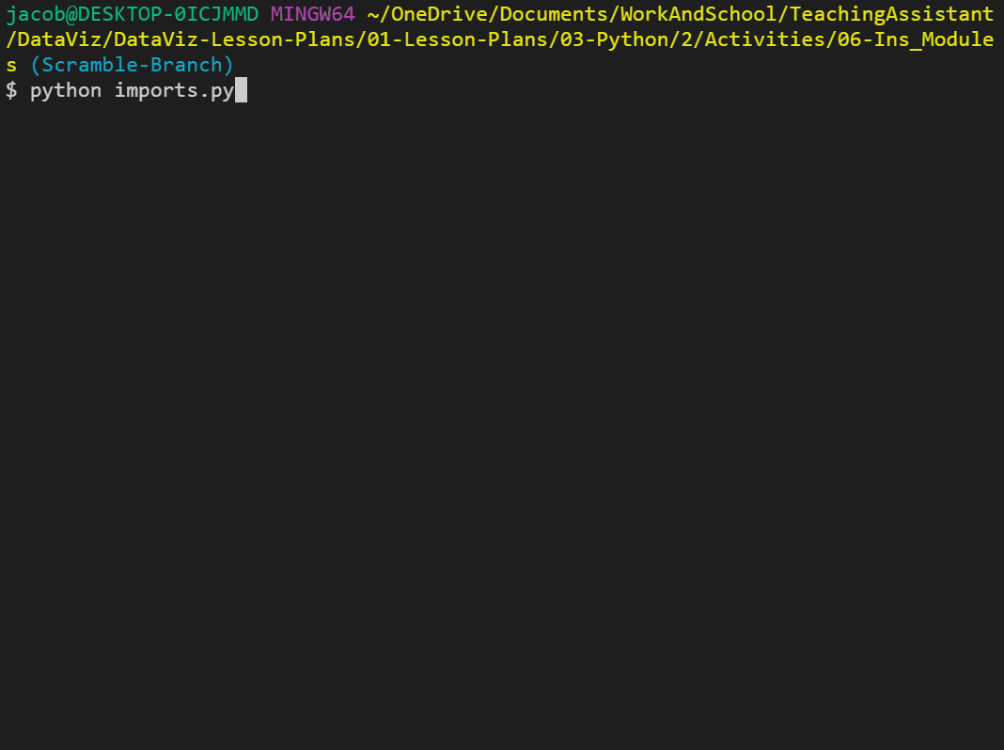
Introduction to Modules
Import Modules
The random module does exactly what one might expect, it allows Python to randomly select values from set ranges, lists, or even strings.
Notes:
4.2
Open up 06-Ins_Modules/imports.py within your editor and show the class how to import modules into their code.
Work in progress….

Slide 26
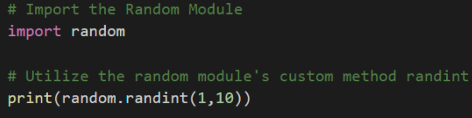
Introduction to Modules
Import Modules
The random module does exactly what one might expect, it allows Python to randomly select values from set ranges, lists, or even strings.
Notes:
Open up 06-Ins_Modules/imports.py within your editor and show the class how to import modules into their code.
NOTE: THIS IS NOT AN ACTUAL SLIDE!! REFERRED TO SLIDE 25

Slide 27
Notes:
Return to the lesson plan and continue with the instructions for the remainder of the activity.

Slide 28
Activity: Module Playground
In this activity, you will have the opportunity to explore some of Python’s modules and play around with them.
5 Minutes
Notes:
4.3
The class will come back together after a couple of minutes to discuss some of the modules that were uncovered before moving on.
Slack the link below, if you find it necessary. You may encourage the students to source for modules they are looking for.
Links:
List of Built-In Python Modules

Slide 29

Activity: Module Playground
Instructions:
There are tons of built-in modules for Python and there is no possible way that a single class could cover all of them.
Source yourself Built-In Python modules and share with the class.
Hint:
Use your Google-fu skills.
Notes:
4.3
Give students 3 minute to source built-in modules
The class will come back together after a couple of minutes to discuss some of the modules that were uncovered before moving on.
Slack the link below, if you find it necessary. You may encourage the students to source for modules they are looking for.
Links:
List of Built-In Python Modules

Slide 30
Notes:
4.4
Check LP or see below:
Call the class back together and ask if there were any modules in particular that folks found useful. Have those students that answer stand and discuss the module that they found and how it could be used.
If no one offers up any modules that they found, feel free to call upon some random students to encourage engagement.

Slide 31

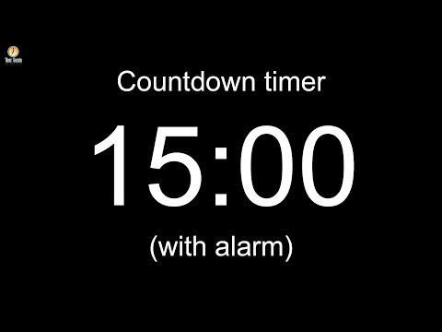
Notes:
-------------------
Image source: AdobeStock_56885471

Slide 32
Reading in CSV Files
Notes:
5.1

Slide 33
It is more likely within the data industry to run across files known as CSV files.
Notes:
5.1
While reading in text files can be useful in some circumstances, it is more likely within the data industry to run across files known as CSV files.

Slide 34
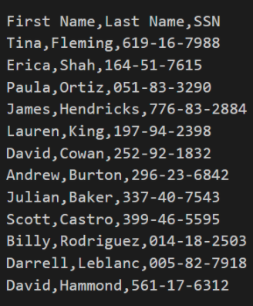
Reading in CSV Files
Comma Separated Values
CSV stands for Comma Separated Values and is essentially a table that has been converted into text format with each row and column being separated by specified symbols.
More often than not each row is located on a new line and each column is separated by a comma. Seems simple enough since this is why the file type is called Comma Separated Values.
Notes:
5.1

Slide 35
Python has a module called csv which pulls in data from external CSV files and perform some operations upon them.
Notes:
5.1
Python has a module called csv which allows its users to easily pull in data from external CSV files and perform some operations upon them.

Slide 36
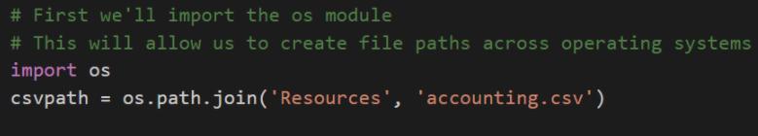
Reading in CSV Files
os module
The first major piece of code to point out is the importing and usages of the os module. This module allows Python programmers to very easily create dynamic paths to external files that function across different operating systems.
Notes:
5.1
Check LP - Open up 07-ReadCSV within the editor and go over the code contained within with the class.
Or see below for opened ReadCVS
# First we'll import the os module
# This will allow us to create file paths across operating systems
import os
# Module for reading CSV files
import csv
csvpath = os.path.join('..', 'Resources', 'accounting.csv')
# # Method 1: Plain Reading of CSV files
# with open(csvpath, 'r') as file_handler:
# lines = file_handler.read()
# print(lines)
# print(type(lines))
# Method 2: Improved Reading using CSV module
with open(csvpath) as csvfile:
# CSV reader specifies delimiter and variable that holds contents
csvreader = csv.reader(csvfile, delimiter=',')
print(csvreader)
# Read the header row first (skip this step if there is now header)
csv_header = next(csvreader)
print(f"CSV Header: {csv_header}")
# Read each row of data after the header
for row in csvreader:
print(row)

Slide 37
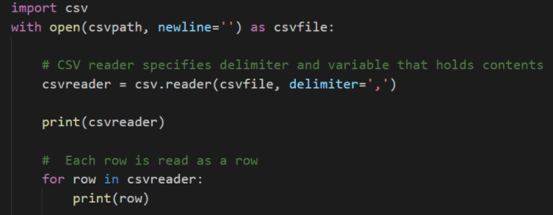
Reading in CSV Files
csv reader
Instead of text.read(), this new code instead utilizes csv.reader() to translate the object being opened by Python. It is critical to note the delimiter=’,’ parameter being used as this tells Python that each comma within the CSV should be seen as moving into a new column for a row.
Notes:
5.1
NOTE :
Reiterate to students that the reading of the file must be done within with open() statement. Outside of that block of code, the variable csvreader will not be useful because the file will be closed when the with open() block ends. In a later example, students will see that one option for working with the data outside of with open() is to append it to a list.

Slide 38
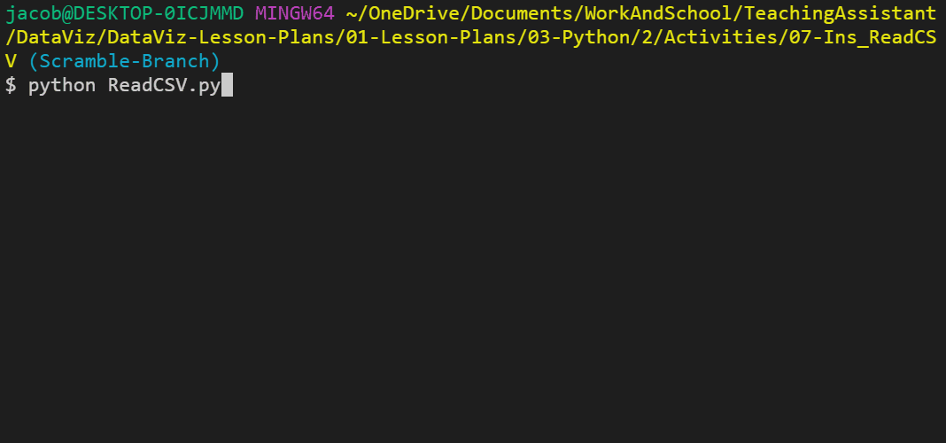
Reading in CSV Files
csv reader
The code then loops through each row of the CSV and prints out the contents. Make sure to point out how each value is being shown as a string and how all of the rows are lists.
Notes:
5.1
NOTE :
Reiterate to students that the reading of the file must be done within with open() statement. Outside of that block of code, the variable csvreader will not be useful because the file will be closed when the with open() block ends. In a later example, students will see that one option for working with the data outside of with open() is to append it to a list.

Slide 39
Notes:
Return to the lesson plan and continue with the instructions for the remainder of the activity.

Slide 40
Activity: Reading Netflix
In this activity, you will be provided with a CSV file containing data taken from Netflix to create an application which searches through the data for a specific movie/show and returns the name, rating, and review score for it.
15 Minutes
Notes:
5.2

Slide 41
Activity: Reading Netflix
Instructions:
Prompt the user for what video they are looking for.
Search through the netflix_ratings.csv to find the user's video.
If the CSV contains the user's video then print out the title, what it is rated and the current user ratings.
For example: ‘Grease is rated PG with a rating of 86’
Bonus:
You may have noticed that there is more than one listing for some videos.
Edit your code to have the title, the rating and user rating printed out only once.
Set a variable to False to check if we found the video.
In the for loop change the variable to confirm that the video is found.
Insert a break statement into the for loop to stop the loop when the first movie is found. Check your Slack for documentation.
If the CSV does not contain the user's video then print out a message telling them that their video could not be found
Notes:
5.2
Slack documentation https://docs.python.org/3.6/reference/simple_stmts.html#break

Slide 42
Notes:
5.3
Check lesson plan
Slack out the 09-Stu_ReadNetFlix/netflix.py of the previous activity and go over the code with the class, answering whatever questions they may have.

Slide 43
Writing CSV Files
Notes:
6.1

Slide 44
We all know Python can read data in from CSVs. Now, can we also write data to a CSV? Let’s find out!
Notes:
6.1

Slide 45
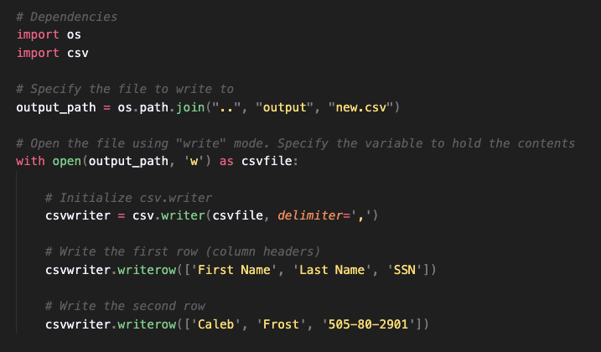
Writing CSV Files
Lost in Translation?
os.path.join(“..”, “output”, “new.csv”) commands Python the file to write to while assign it to the variable output_path.
with open(output_path, ‘w’) as csvfile: is telling Python to open the file using ‘write’ mode while holding the contents in output_path.
csv.writer() is telling Python that this application will be writing code into an external CSV file.
csv.writerow() is the code to write a new row into a CSV file.
Notes:
6.1
NOTE : Lost in translation? Is just a funny way to give a ‘title’ translate the code image on slide. (In case a student asks)
Open up 10-Ins_WriteCSV/write.py within the editor and go through the code with the class, explaining each line as you go along.
Run the code and then open up the new CSV file create to show students that the application was successful.
The syntax for writing into a CSV file is thankfully very similar to that used to read data in from an external file.
First, the code references the path that will point into the CSV file the user would like to write to.
Next, the with open() statement is used once more but with one significant difference. Instead of the parameter ‘r’ being passed and directing Python to read a file, the parameter ‘w’ is passed instead to inform Python to write to the file.
Instead of read.csv(), csv.write() is used to once again inform Python that this application will be writing code into an external CSV file.
To write a new row into a CSV file, simply use the csv.writerow(<DATA FILE>) function and pass in an array of data as the parameter.

Slide 46
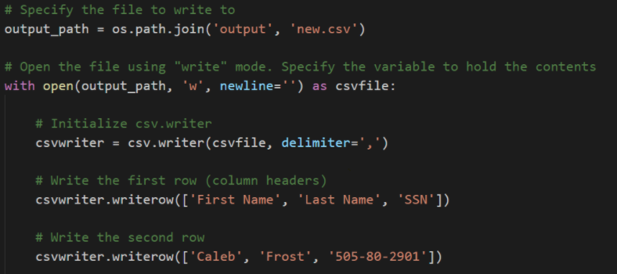
Writing CSV Files
The syntax for writing into a CSV file is thankfully very similar to that used to read data in from an external file.
First, the code references the path that will point into the CSV file the user would like to write to.
Next, the with open() statement is used once more but with one significant difference. Instead of the parameter ‘r’ being passed and directing Python to read a file, the parameter ‘w’ is passed instead to inform Python to write to the file.
Instead of read.csv(), csv.write() is used to once again inform Python that this application will be writing code into an external CSV file.
To write a new row into a CSV file, simply use the csv.writerow(<DATA FILE>) function and pass in an array of data as the parameter.
Notes:
LEAVE THIS SLIDE and ask Joe’s Feedback comparing to slide 45 - delete after!

Slide 47
Zipping Lists
Notes:
6.2

Slide 48
Python users can be far more efficiently write data into a new CSV file by using the zip() function.
Notes:
6.2
While it is possible to write new rows of data into a CSV file using a bunch of csv.writerow() statements, Python users can far more efficiently write data into a new CSV file by using the zip() function.

Slide 49
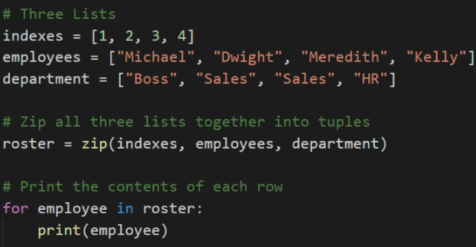
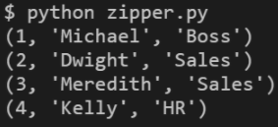
Zipping Lists
zip() takes in a series of lists as its parameters and joins them together into a stack.
By zipping these lists together, there is now a single joined list whose indexes reference all three of the lists inside.
Each zipped object can only be used once. For example, you can write the zipped object to a CSV or print to the terminal, but not both.
Notes:
6.2
Open up 10-Ins_WriteCSV/write.py within the editor and go through the code with the class, explaining each line as you go along.
Run the code and then open up the new CSV file create to show students that the application was successful.
This application has three lists, all of which pertain to each other and are of the same length. By zipping these lists together, there is now a single joined list whose indexes reference all three of the lists inside.
Zipped listed are turned into iterator objects which are similar to tuples, but once they are iterated over they are empty. This means each zipped object can only be used once. For example, you can write the zipped object to a CSV or print to the terminal, but not both.

Slide 50
Notes:
Return to the lesson plan and continue with the instructions for the remainder of the activity.

Slide 51
Activity: Udemy Zip
In this activity, you will be provided with a large dataset from Udemy, clean up, and create CSV file that is far easier to comprehend.
20 Minutes
Notes:
6.3

Slide 52
Activity: Udemy Zip
Instructions:
Create a Python application that reads the data on Udemy Web Development offerings.
Then store the contents of the Title, Price, Subscriber Count, Number of Reviews, and Course Length into Python Lists.
Then zip these lists together into a single tuple.
Finally, write the contents of your extracted data into a CSV. Make sure to include the titles of these columns in your CSV.
Notes:
As, with many datasets, the file does not include the header line. Use the below as a guide on the columns: "id, title, url, isPaid, price, numSubscribers, numReviews, numPublishedLectures, instructionalLevel, contentInfo, publishedTime"
Bonus:
Find the percent of subscribers that have also left a review on the course. Include this in your final output.
Parse the string associated with course length, such that we store it as an integer instead of a string. (i.e. "4 hours" should be converted to 4).
Notes:
6.3
Now that students have a decent idea on how to write/read data to/from CSV files, they will now take a large dataset from Udemy, clean it up, and create a new CSV file that is far easier to comprehend.
After comparing the 12-Stu_UdemyZip/Resources/web_starter.csv to the 12-Stu_UdemyZip/Solved/web_final.csv of this activity in order to show students how their application should function, slack out the following file and instructions.

Slide 53
Notes:
6.4
Check LP or see below:
Open up and slack out the 12-Stu_UdemyZip/web_solved.py of the previous activity and go over the code line by line with the class, answering whatever questions they may have.
Key points to cover during this discussion:
There are six empty lists created at the start of this application, all of which will be used to hold specific data taken from within the original CSV and ultimately be zipped together before being written to a new CSV file.
For every new row read in from the original CSV file, new data is appended into the lists from earlier. In the cases of percent and length, the data is being altered before being placed into their respective list.
Once all data has been read, the lists are zipped together and written into a new CSV file with a header row being written in beforehand.

Slide 54
Introduction to Functions
Notes:
6.5

Slide 55
DRY - It stands for Don’t Repeat Yourself. It is a very popular acronym among the tech community, and many coders live by it.
Notes:
Ask students if they have any idea why DRY is very popular and why many coders live by it.

Slide 56
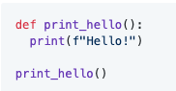
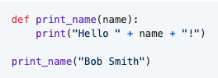
Introduction to Functions
Preventing repetition by liberal usage of Python functions.
A function is a block of organized, reusable code that is used to perform a single, related action. In other words, functions are placeable blocks of code that perform a specific action.
To create a new function, simply use def <FUNCTION NAME>(): and then place the code that you would like to run within the block underneath it.
In order to run the code stored within a function, the function itself must be called within the program. Functions will never run unless called upon.
Functions that take in parameters can also be created by simply adding a variable into the parentheses of the function's definition. This allows specific data to be passed into the function for usage.
Notes:
Open up 13-Ins_Functions/functions.py within the editor and run through the code line-by-line with your class.

